Slide 1
View_2
View_3
SIGN UP with Facebook
SIGN UP with Google+
LOGO
+
Flashcards
Or, Create a new account
Username
Username
Password
Password
Password (again)
Email
LOG IN
I am under the age of 13
I have read the Terms and Services and therefore agree to it.
LOG IN
with Facebook
LOG IN
with Google+
SIGN UP
LOGIN
SIGNUP

Slide 2
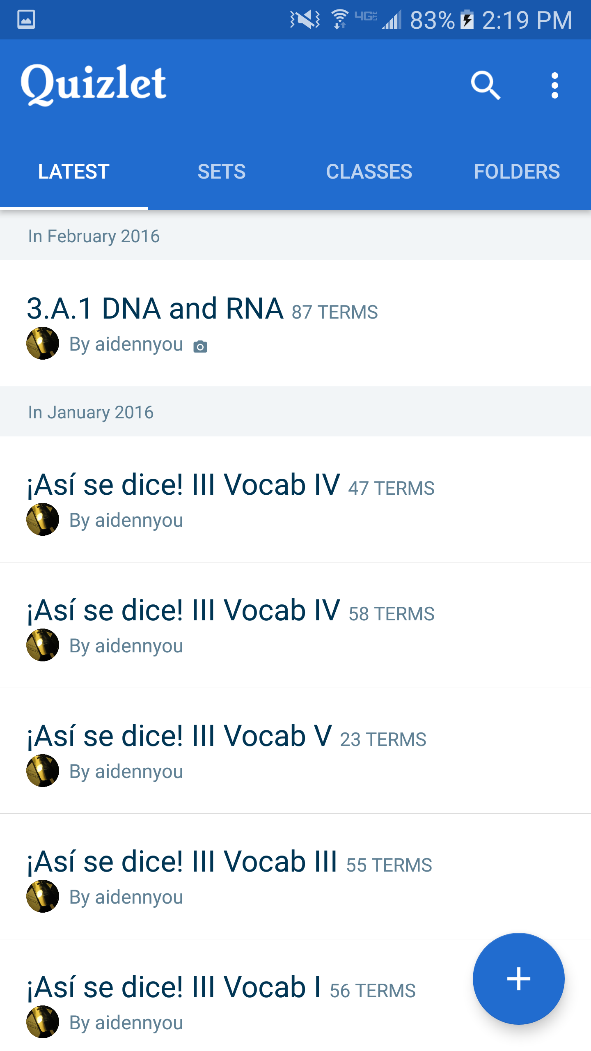
View_4
LOGO
Q
B_5
...
Latest B_1 | Sets B_2 | Class B_3 | Folder B_4
MENU

Slide 3
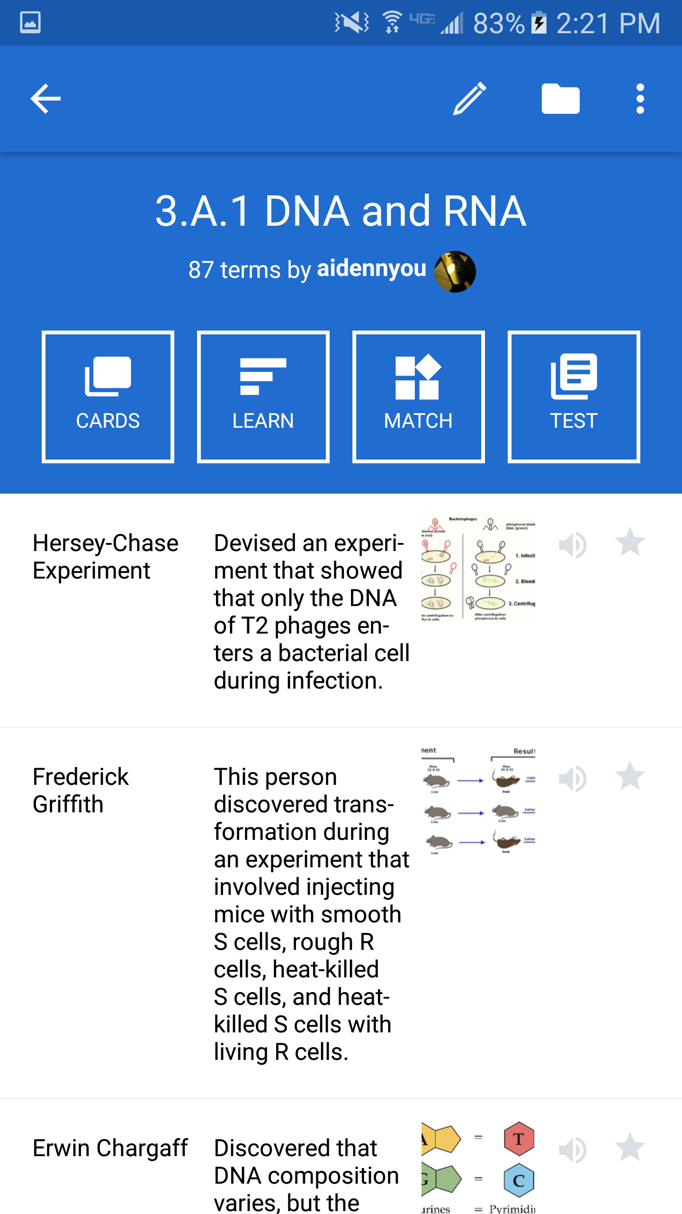
View_5
←
...
SET TITLE
# terms by creator
Flashcards
B_1
Learn
B_2
Match
B_3
WORDBOOKLIST

Slide 4
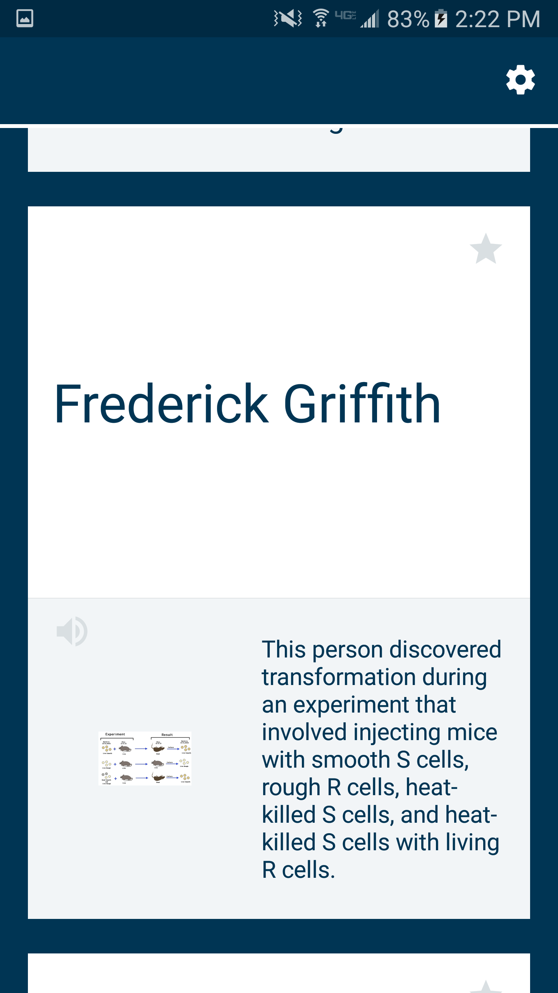
View_6
←
...
WORD
DEFINITION
WORDBOOK

Slide 5
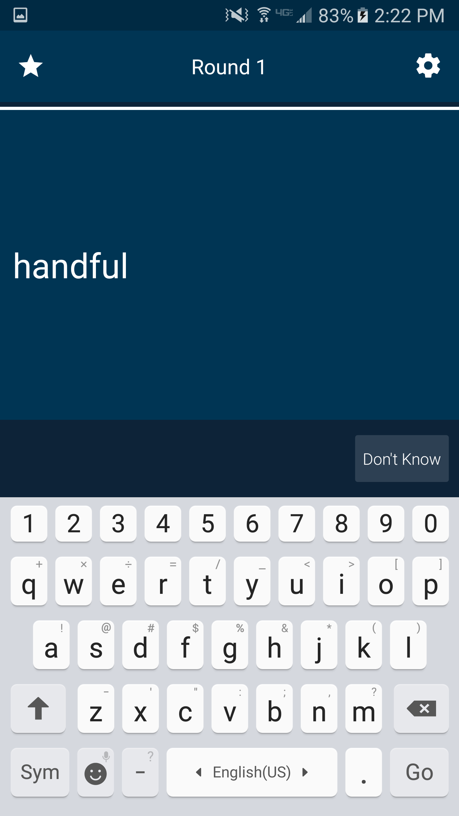
View_7
←
...
DEFINITION
Type Answer
Don’t Know
WORD

Slide 6
View_8
View_9
←
...
←
username
Account Settings
Log out of username
Support
Send Feedback
MATCH
(GAME)
Rate Us!
About
Privacy Policy
Terms of Service
MATCH
SETTING

Slide 7
View_10
View_11
←
LOGO
Q
B_5
...
←
LOGO
...
+
+
User Name
Folder Name
Folder 1
Set 1
Folder 2
Set 2
Folder 3
Set 3
Folder 4
Set 4
FOLDER
SUBFOLDER

Slide 8
No sign-up button on view-2
Need to create activities for all the settings, send feedback, etc
Create Class B_3 and Folder B_4
Sign up with Facebook and Google plus
Policy and Terms of Service

